Slide 1

Bankruptcy Prediction
Project Presentation
Machine Learning
Falgunee Warutkar

Slide 2
Table Of ContentS:
Business Understanding :
Business objectives , problem statement
Data Understanding:
Data description, exploration, quality assessment
Data Preparation :
Data cleanup, preparation, formatting , Feature selection
Modeling:
Training and Testing the models
Evaluation :
Model evaluation, performance reporting , Performance after Tunning Features
Visualization :
Result analysis, visualization, conclusion

Slide 3
Problem Statement
Bankruptcy prediction on the basis of given financial statements containing various financial ratios which are the key indicators of financial soundness of a business and thus predict distress and bankruptcy one to five years in advance.

Slide 4
1. BUSINESS UNDERSTANDING
What is Bankruptcy?
Bankruptcy is a legal status of a person or other entity that cannot repay debts to creditors.
Upon the successful completion of bankruptcy proceedings, the debtor is relieved of the debt obligations incurred prior to filing for bankruptcy.

Slide 5
What is Bankruptcy Prediction?
Bankruptcy prediction is the art of predicting bankruptcy and various measures of financial distress of public firms.
It is a vast area of finance and accounting research and is important due in part to the relevance for creditors and investors in evaluating the likelihood that a firm may go bankrupt.
The history of bankruptcy prediction includes application of numerous statistical tools which gradually became available, and involves deepening appreciation of various pitfalls in early analysis.
The area is well-suited for testing of increasingly sophisticated, data-intensive forecasting approaches.

Slide 6
Challenges in Bankruptcy Prediction :
Problem collecting the data also the collected is sparse.
Gathering the data on time.
The features on which the bankruptcy prediction is based, are not as straightforward as the financial ratios found on the balance sheets of the companies.
Also, Some companies might go bankrupt in the first year itself, while others perform well in the first 2 years but might go bankrupt in the 3rd year.
Handling large and imbalance data.
Handling missing data and finding best suited classification model .
Enhancing performance evaluation metrics.

Slide 7

2. DATA UNDERSTANDING
Dataset : bankruptcy prediction of Polish companies.
The data was collected from Emerging Markets Information Service (EMIS), which is a database containing information on emerging markets around the world.
The bankrupt companies were analyzed in the period 2000-2012, while the still operating companies were evaluated from 2007 to 2013.
All data files have multivariate data and is intended to be used for classification task.
All the features are numeric (Real) values and data set has missing values.

Slide 8
Basing on the collected data five classification cases were distinguished, that depends on the forecasting period:
Data File | Description | # Instances | # Bankrupt instances in this forecasting period | # Non-Bankrupt instances in this forecasting period
Year 1 | Data for: 1st year of the forecasting period Label indicates: Bankruptcy status after 5 years. | 7027 | 271 | 6756
Year 2 | Data for: 2nd year of the forecasting period Label indicates: Bankruptcy status after 4 years. | 10173 | 400 | 9773
Year 3 | Data for: 3rd year of the forecasting period Label indicates: Bankruptcy status after 3 years. | 10503 | 495 | 10008
Year 4 | Data for: 4th year of the forecasting period Label indicates: Bankruptcy status after 2 years. | 9792 | 515 | 9277
Year 5 | Data for: 5th year of the forecasting period Label indicates: Bankruptcy status after 1 year. | 5910 | 410 | 5500

Slide 9
Features:
There are a total of 64 features in the dataset, where each feature is constructed using two or more core econometric indicators.
Hence each feature is actually a synthetic feature.
The synthetic features are formulated by performing arithmetic operation(s) on the core indicators.
The purpose of the synthetic features is to combine the econometric indicators into complex features.
The synthetic features can be seen as hidden features extracted by the neural networks but the fashion they are extracted is different.

Slide 10
Features
ID | Description
X1 | net profit / total assets
X2 | total liabilities / total assets
X3 | working capital / total assets
X4 | current assets / short-term liabilities
X5 | [(cash + short-term securities + receivables - short-term liabilities) / (operating expenses - depreciation)] * 365
X6 | retained earnings / total assets
X7 | EBIT / total assets
X8 | book value of equity / total liabilities
X9 | sales / total assets
X10 | equity / total assets
X11 | (gross profit + extraordinary items + financial expenses) / total assets
X12 | gross profit / short-term liabilities
X13 | (gross profit + depreciation) / sales
X14 | (gross profit + interest) / total assets
X15 | (total liabilities * 365) / (gross profit + depreciation)
X16 | (gross profit + depreciation) / total liabilities
ID | Description
X17 | total assets / total liabilities
X18 | gross profit / total assets
X19 | gross profit / sales
X20 | (inventory * 365) / sales
X21 | sales (n) / sales (n-1)
X22 | profit on operating activities / total assets
X23 | net profit / sales
X24 | gross profit (in 3 years) / total assets
X25 | (equity - share capital) / total assets
X26 | (net profit + depreciation) / total liabilities
X27 | profit on operating activities / financial expenses
X28 | working capital / fixed assets
X29 | logarithm of total assets
X30 | (total liabilities - cash) / sales
X31 | (gross profit + interest) / sales
X32 | (current liabilities * 365) / cost of products sold

Slide 11
ID | Description
X33 | operating expenses / short-term liabilities
X34 | operating expenses / total liabilities
X35 | profit on sales / total assets
X36 | total sales / total assets
X37 | (current assets - inventories) / long-term liabilities
X38 | constant capital / total assets
X39 | profit on sales / sales
X40 | (current assets - inventory - receivables) / short-term liabilities
X41 | total liabilities / ((profit on operating activities + depreciation) * (12/365))
X42 | profit on operating activities / sales
X43 | rotation receivables + inventory turnover in days
X44 | (receivables * 365) / sales
X45 | net profit / inventory
X46 | (current assets - inventory) / short-term liabilities
X47 | (inventory * 365) / cost of products sold
X48 | EBITDA (profit on operating activities - depreciation) / total assets
ID | Description
X49 | EBITDA (profit on operating activities - depreciation) / sales
X50 | current assets / total liabilities
X51 | short-term liabilities / total assets
X52 | (short-term liabilities * 365) / cost of products sold)
X53 | equity / fixed assets
X54 | constant capital / fixed assets
X55 | working capital
X56 | (sales - cost of products sold) / sales
X57 | (current assets - inventory - short-term liabilities) / (sales - gross profit - depreciation)
X58 | total costs /total sales
X59 | long-term liabilities / equity
X60 | sales / inventory
X61 | sales / receivables
X62 | (short-term liabilities *365) / sales
X63 | sales / short-term liabilities
X64 | sales / fixed assets

Slide 12
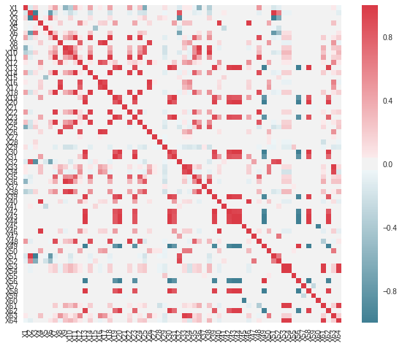
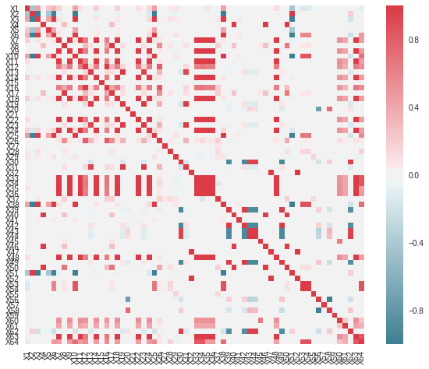
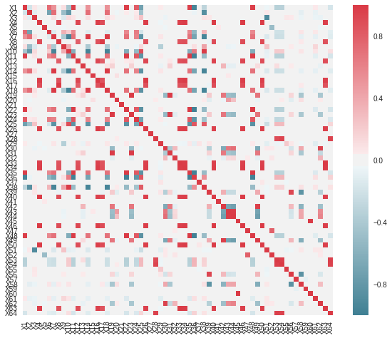
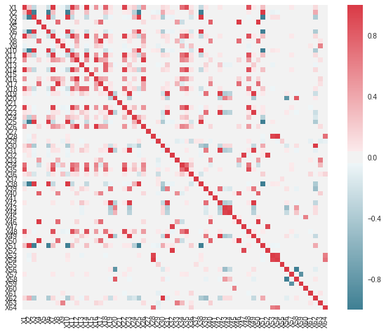
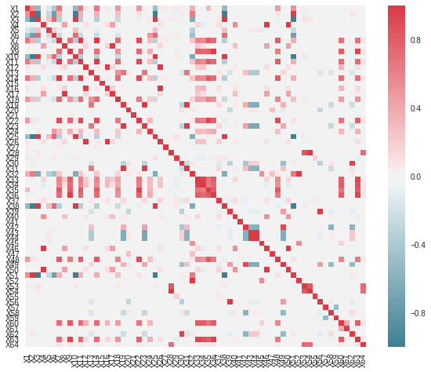
Analyzing the Data
Observing the correlation among variables for 5 years

Slide 13
Data Imbalance
Column 5 clearly shows the population percentage of the minority class, i.e., the Bankruptcy class label, among the total population of the dataset. These numbers in column 5 tell us that there is a huge data imbalance.
Data Set
Year 1
Year 2
Year 3
Year 4
Year 5
Data Set | # Instances | # Bankrupt instances in this forecasting period | # Non-Bankrupt instances in this forecasting period | Percentage of minority class samples
Year 1 | 7027 | 271 | 6756 | 3.85 %
Year 2 | 10173 | 400 | 9773 | 3.93 %
Year 3 | 10503 | 495 | 10008 | 4.71 %
Year 4 | 9792 | 515 | 9277 | 5.25 %
Year 5 | 5910 | 410 | 5500 | 6.93 %

Slide 14
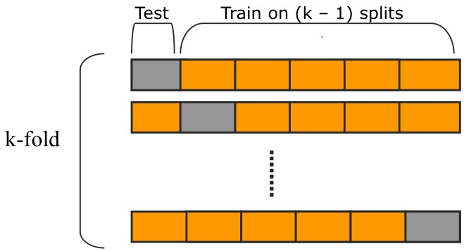
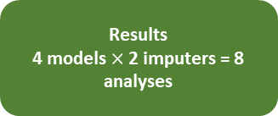
Modeling Pipeline
Raw Data
(.arff files)
Formatted 5 Years’ Data
k-NN
Imputation
Mean
Imputation
K-Fold Cross Validation Procedure
SMOTE Oversampling
Modeling with 6 models:
DT, RF, XGB,LR
Results
4 models $×$ 2 imputers = 8 analyses
Bankruptcy Prediction: Mining the Polish Bankruptcy Data
14

Slide 15
3. DATA PREPARATION
In this section:
1.Dealing with missing data
Mean Imputation
k-NN Imputation
2.Feature Selection
RFE
3. Dealing with data imbalance
SMOTE Oversampling

Slide 16
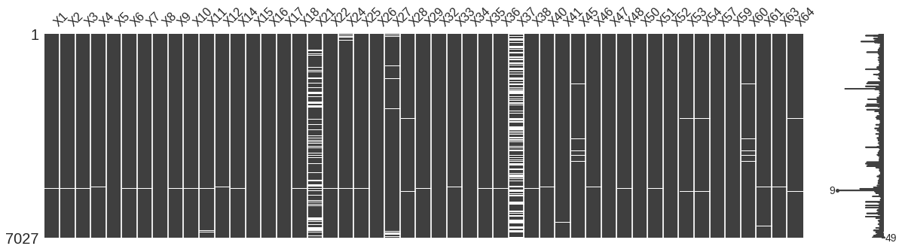
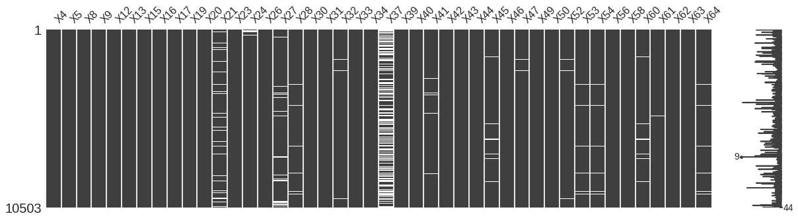
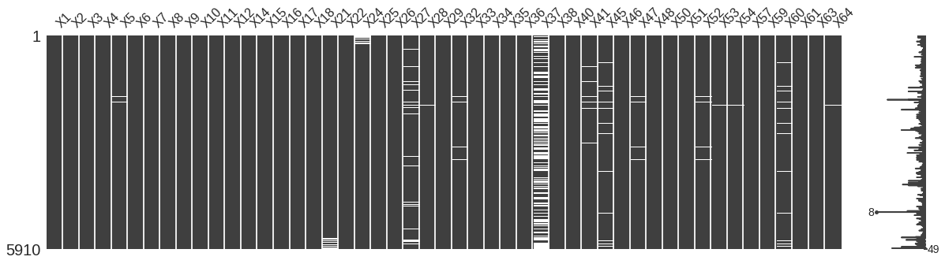
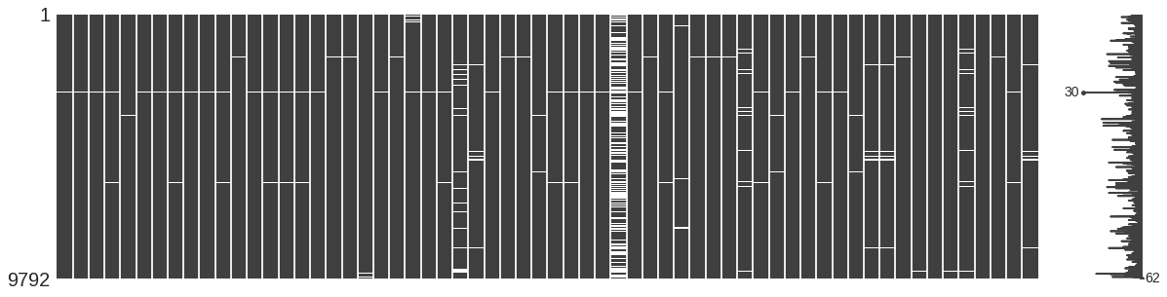
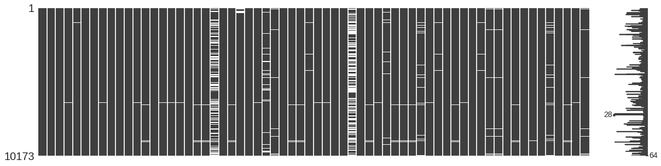
Viewing the Missingness of Data
Observing the Missing's of data

Slide 17
1.Dealing with missing data
Mean Imputation
Mean imputation technique involves replacing any missing value with the mean of that variable.
k-NN Imputation
k-NN is a non-parametric method used for classification and regression.
The input consists of the k closest training examples in the feature space.
It can also be used as a data imputation technique.
k-NN imputation replaces NaNs in data with the corresponding value from the nearest-neighbor row or column.
The nearest-neighbor row or column is the closest row or column by Euclidean distance.

Slide 18
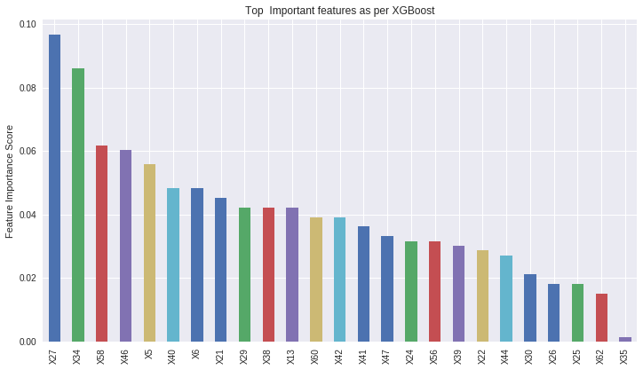
Feature Selection Using RFE

Slide 19
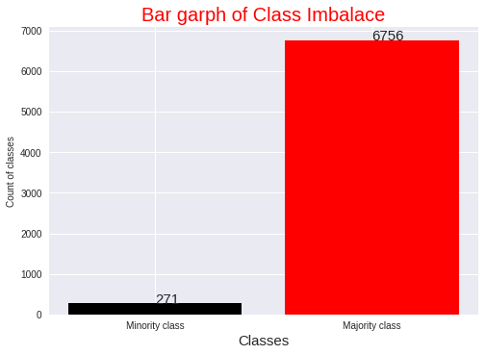
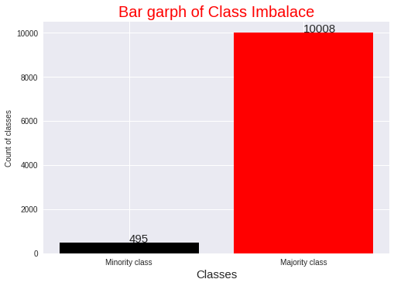
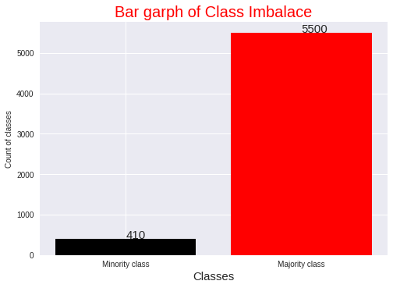
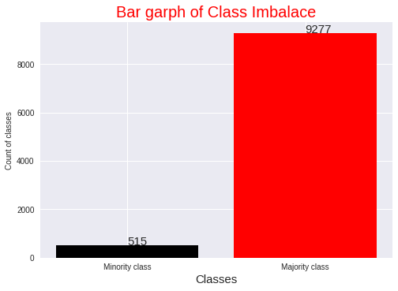

Dealing with Data imbalance

Slide 20
Dealing with Data imbalance
Data Imbalance can be treated with Oversampling and Undersampling.
In data analysis, Oversampling and Undersampling are techniques used to adjust the class distribution of a data set.
Oversampling is increasing the class distribution of the minority class label.
Undersampling is decreasing the class distribution of the majority class label.
We explored SMOTE Oversampling technique.

Slide 21

SMOTE Oversampling
SMOTE: Synthetic Minority Over-sampling Technique is a widely used oversampling technique.
To illustrate how this technique works consider some training data which has $s$ samples, and $f$features in the feature space of the data, assuming the features to be continuous.
To oversample, take a sample from the dataset, and consider its $k$ nearest neighbors in the feature space. To create a synthetic data point, take the vector between one of those k neighbors, and the current data point.
Multiply this vector by a random number x which lies between 0 and 1. Adding this to the current data point will create the new synthetic data point.

Slide 22
Training –Testing Procedure
After Feature Selection we trained our data by applying Stratified Kfold on selected features on the first year.
Then we tested on consecutive years and observed the :
Accuracy
Precision
Recall
For all different classification algorithms

Slide 23

5. EVALUATION
Evaluation and performance reporting of:
Decision Trees
Random Forests
Extreme Gradient Boosting
Logistic Regression

Slide 24

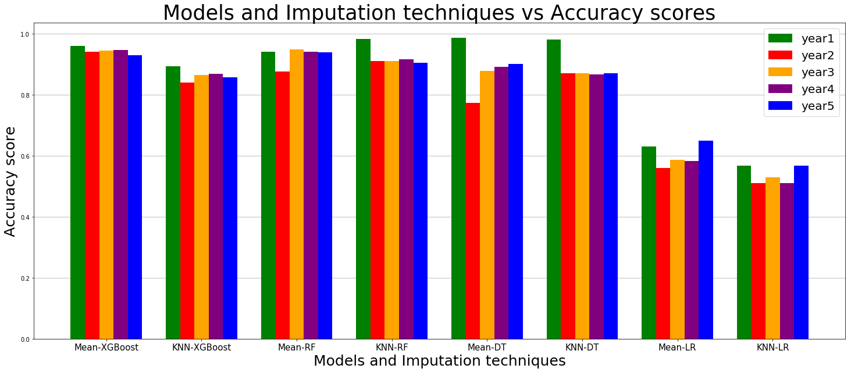
Model evaluation metrics considered are Accuracy, Precision ,Recal and Roc curve.
1.Imputer selected –Mean
2.Model selected-Xgboost

Slide 25
Precision
Precision attempts to answer the following question:
What proportion of positive identifications was actually correct?
Precision is defined as follows:
Precision=TP/TP+FP
If Precision= 0.5
Our model has a precision of 0.5—in other words, when it predicts a company is going to be bankrupt, it is correct 50% of the time.

Slide 26
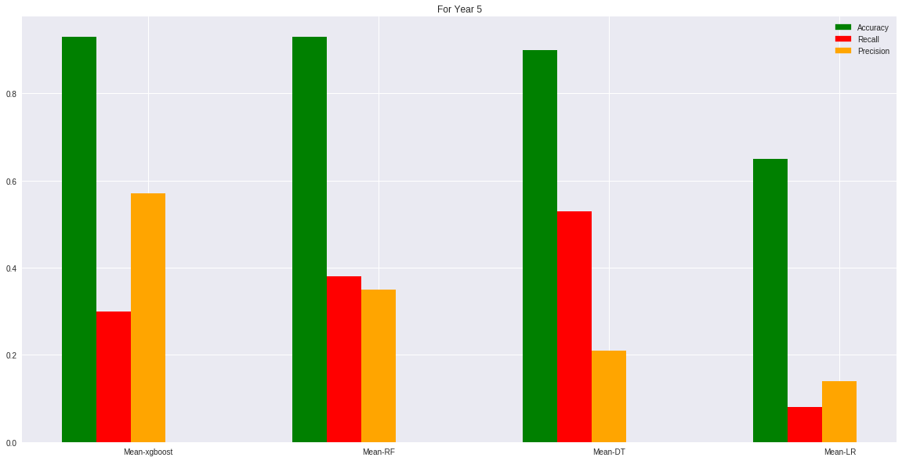
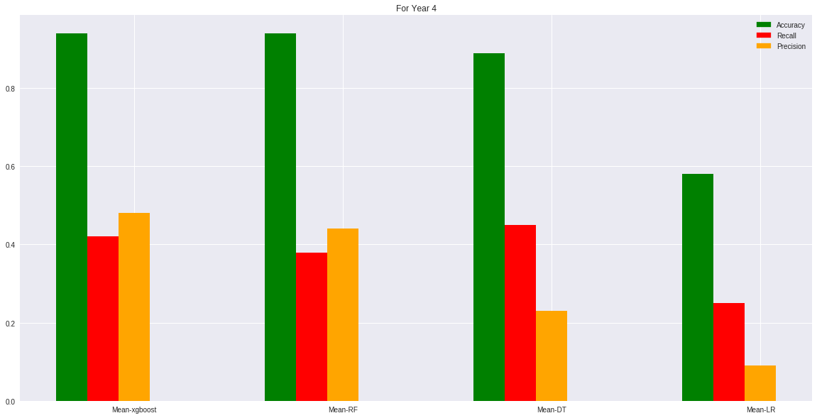
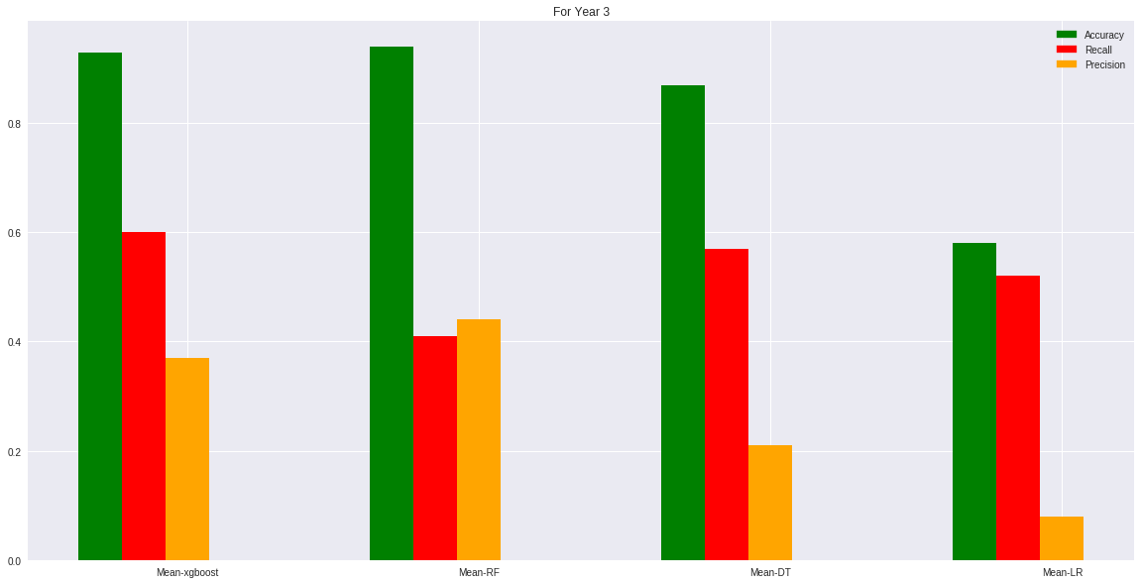
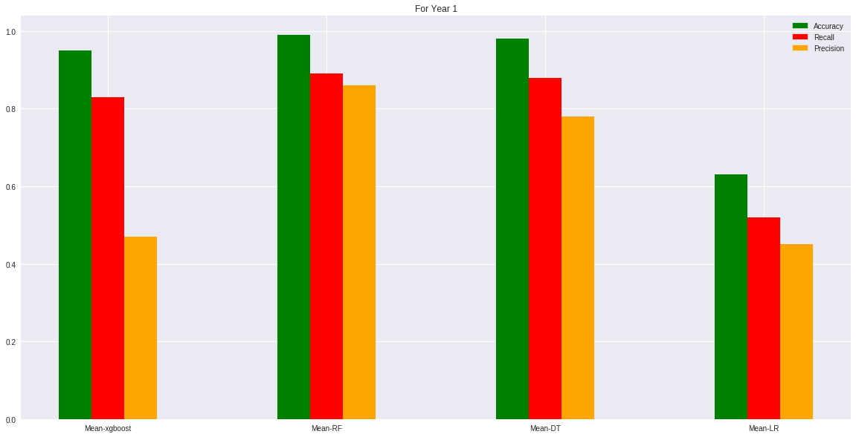
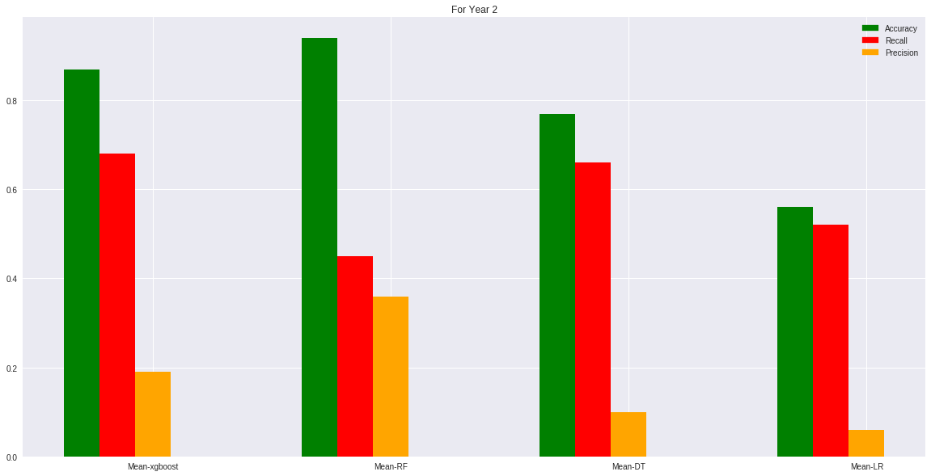
Plots for Performance metrics:Accuracy,precision,recall and Roc Curve

Slide 27
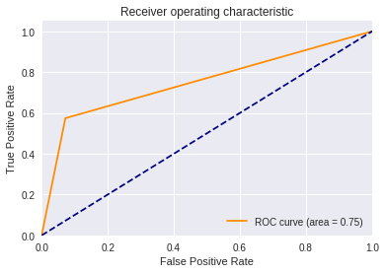
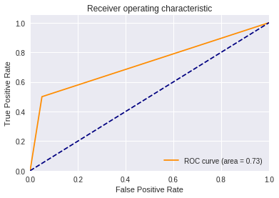
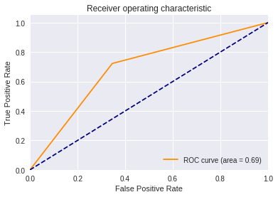
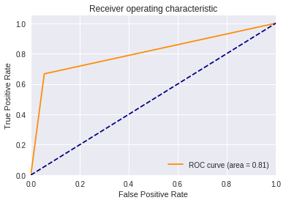
DT
RT
LR
xgboost

Slide 28
Xgboost Classifier + Mean Imputation +Parameter Tuning
Tunning done in following rounds:
Round 1: Tune max_depth and min_child_weigh
Round 2: Tune subsample and colsample_bytree
Round 3: Tune reg_alpha
Round 4: Tune estimators
Round 5: Tune learning_rate

Slide 29
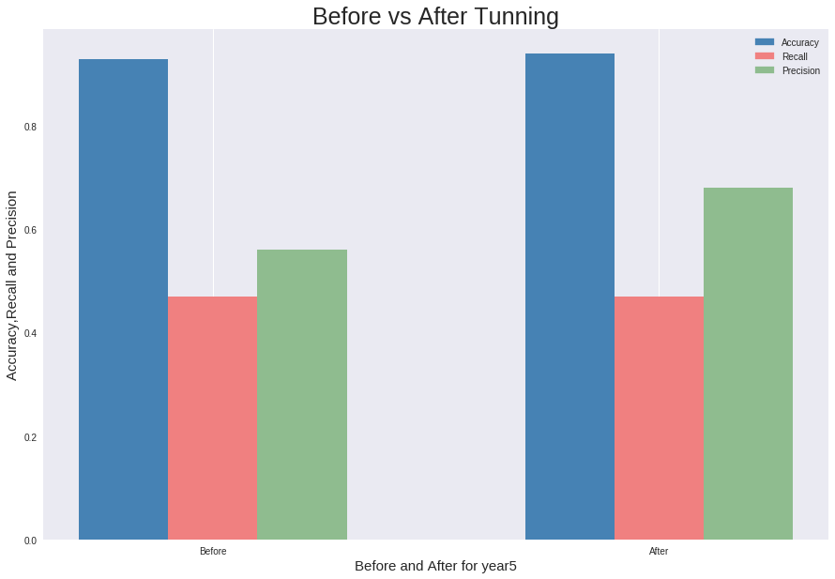
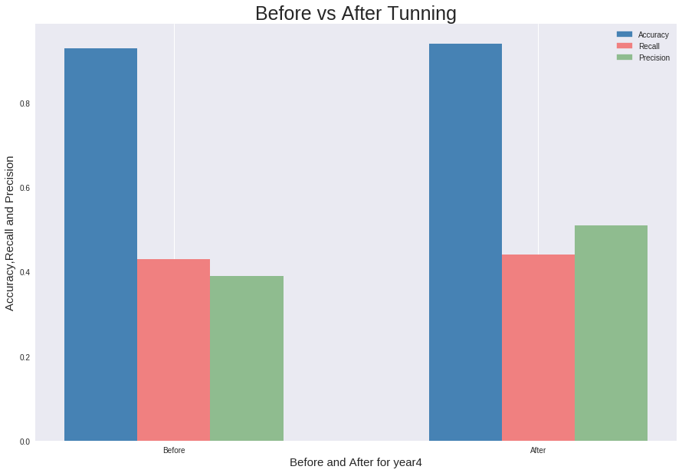
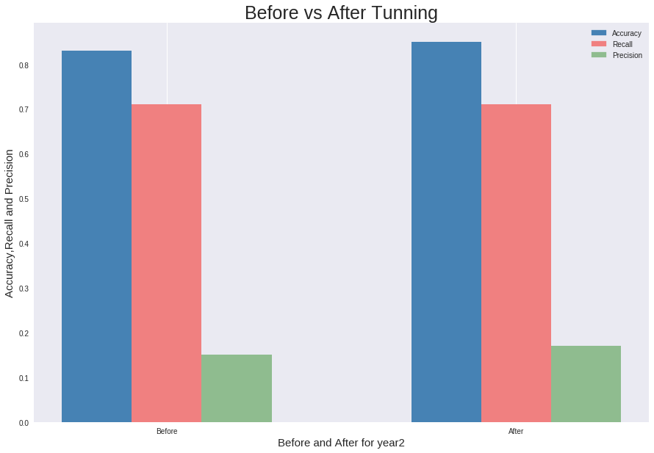
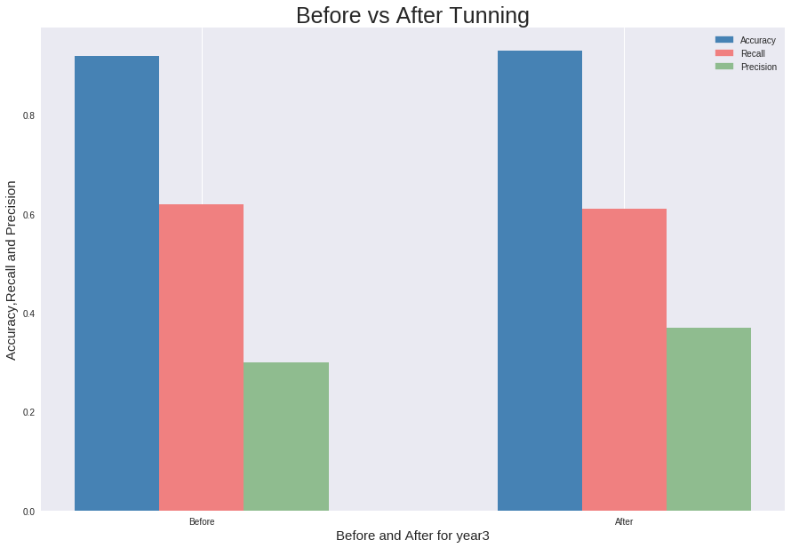
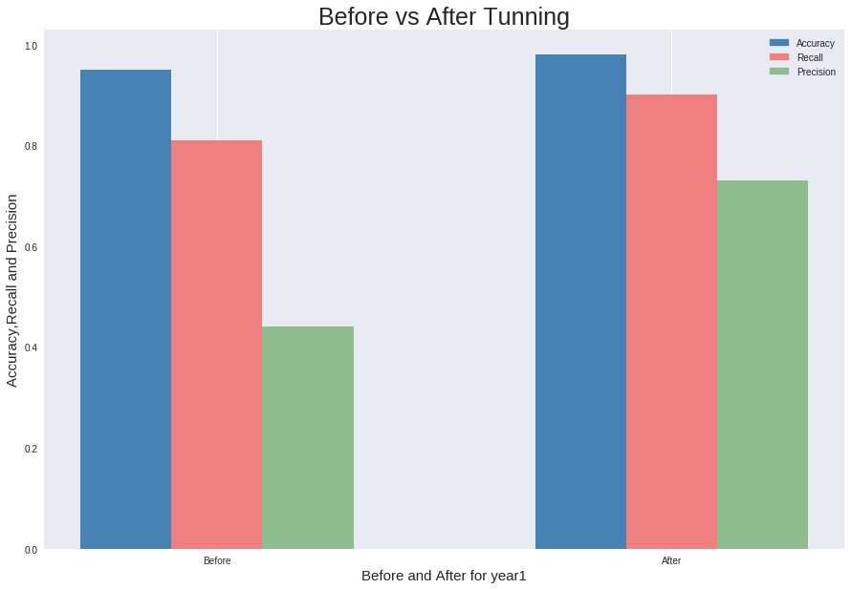

Slide 30
Conclusion
On the concluding note:
1.Successfully determine best model+imputer on the basis of metrics -Precision and Recall.
2.Successfully tuned the parameters of best model and increased required metrics.
3.Our model was able to predict company is bankrupt 40-80% of the times correctly in
context of 5 different years.

Slide 31
Thank You

